Slide 1
14439 – The Snack Safe

Slide 2
Outline
Description
Input & Output
Basic testcase
Concept & Code

Slide 3
Outline
Description
Input & Output
Basic testcase
Concept & Code

Slide 4
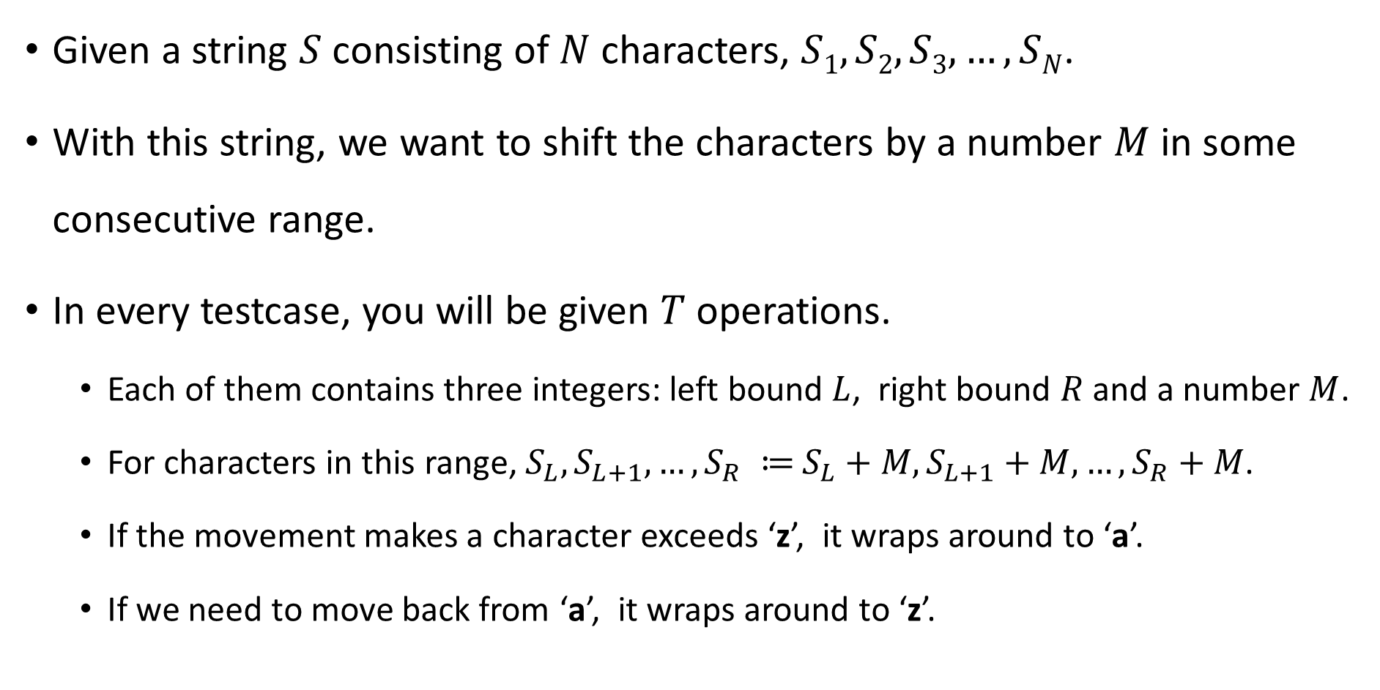
Description
Given a string $S$ consisting of $N$ characters, $S1, S2, S3, …, SN$.
With this string, we want to shift the characters by a number $M$ in some consecutive range.
In every testcase, you will be given $T$ operations.
Each of them contains three integers: left bound $L$, right bound $R$ and a number $M$.
For characters in this range, $S_{L}, S_{L+1}, …, S_{R} ≔$ $S_{L}+M, S_{L+1}+M, …, S_{R}+M\text{.}$
If the movement makes a character exceeds ‘z’, it wraps around to ‘a’.
If we need to move back from ‘a’, it wraps around to ‘z’.

Slide 5
Outline
Description
Input & Output
Basic testcase
Concept & Code

Slide 6
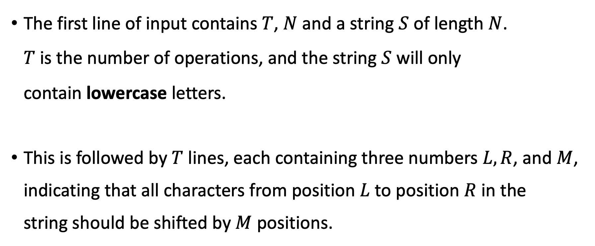
Input
The first line of input contains $T$, $N$ and a string $S$ of length $N$. $T$ is the number of operations, and the string $S$ will only contain lowercase letters.
This is followed by $T$ lines, each containing three numbers $L, R$, and $M$, indicating that all characters from position $L$ to position $R$ in the string should be shifted by $M$ positions.

Slide 7

Input
Constraints:
$1 ≤ T, N ≤ {10}^{6}$
$−{10}^{9} ≤ M ≤ {10}^{9}$
$1 ≤ L ≤ R ≤ N$
Subtasks:
Testcases 1 ~ 3: $1 ≤ T ≤1000$
Testcases 4 ~ 6: No additional restrictions.

Slide 8

Output
Output the string $S$ after $T$ operations.
Please remember to print "\n" at the end.

Slide 9
Outline
Description
Input & Output
Basic testcase
Concept & Code

Slide 10
Basic testcase
sample input
sample output
5 4 ouob
2 3 9
4 4 12
1 4 3
1 3 5
2 4 1
wmgr

Slide 11

Basic testcase
Operation 1: [2, 3, 9]
$S$ Sequence :
+9
o | u | o | b
+9

Slide 12
Basic testcase
Operation 1: [2, 3, 9]
$S$ Sequence :
+9
o | (u | o | b
+5) + 4
We can see ‘u’ + 9 as (‘u’ + 5) + 4, and shifting ‘u’ by 5 is ‘z’.

Slide 13
Basic testcase
Operation 1: [2, 3, 9]
$S$ Sequence :
o | z | x | b
+4
Now ‘z’ needs to move 4 more steps forward.
According to the problem rules, we start from ‘a’, so ‘z’ + 4 will be ‘d’.

Slide 14
Basic testcase
Operation 1: [2, 3, 9]
$S$ Sequence :
o | d | x | b

Slide 15

Basic testcase
Operation 2: [4, 4, 12]
$S$ Sequence :
+12
o | d | x | b

Slide 16
Basic testcase
Operation 2: [4, 4, 12]
$S$ Sequence :
o | d | x | n

Slide 17
Basic testcase
Operation 3: [1, 4, 3]
$S$ Sequence :
+3
+3
+3
+3
o | d | x | n

Slide 18
Basic testcase
Operation 3: [1, 4, 3]
$S$ Sequence :
r | g | a | q

Slide 19
Basic testcase
Operation 4: [1, 3, 5]
$S$ Sequence :
+5
+5
+5
r | g | a | q

Slide 20
Basic testcase
Operation 4: [1, 3, 5]
$S$ Sequence :
w | l | f | q

Slide 21
Basic testcase
Operation 5: [2, 4, 1]
$S$ Sequence :
+1
+1
+1
w | l | f | q

Slide 22
Basic testcase
Operation 5: [2, 4, 1]
$S$ Sequence :
w | m | g | r

Slide 23
Basic testcase
Now you know how to handle the testcase, but you might still have the following questions:
How should I handle character shifting?
How do I deal with moving backward from 'a' to 'z' or forward from 'z' to 'a'?
Why do I get TLE (Time Limit Exceeded) in some testcases?

Slide 24
Outline
Description
Input & Output
Basic testcase
Concept & Code

Slide 25
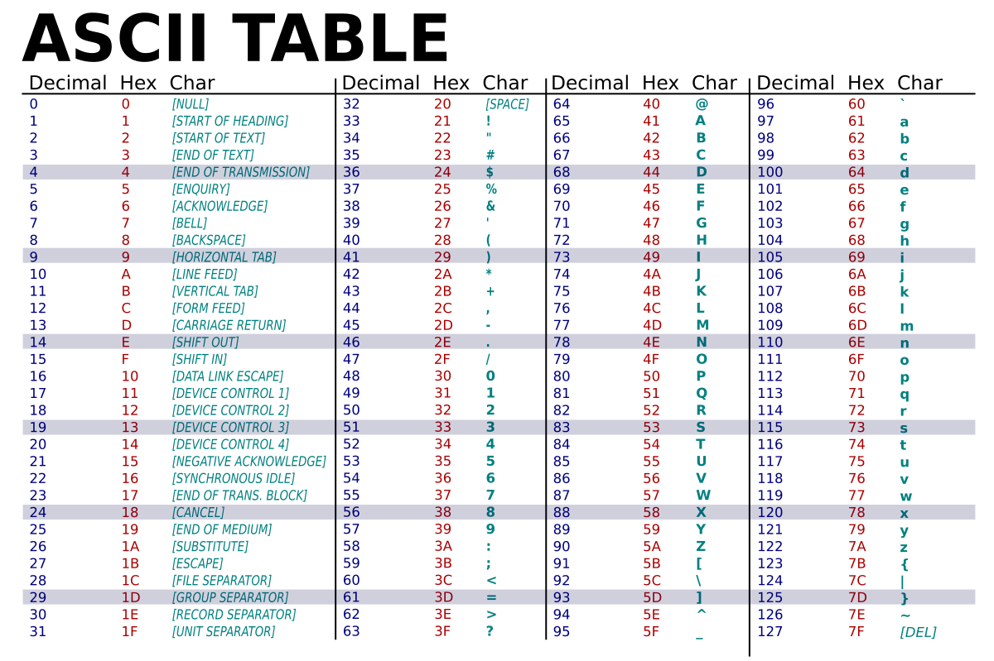
Concept (1 - character shifting)
In C language, characters are stored in the form of ASCII codes.

Slide 26
Concept (1 - character shifting)
Therefore, we can perform mathematical operations directly on characters: the ASCII code for 'a' is 97, so if we want to shift it forward by 3, we can simply do 'a' + 3.
printf("%c", 'a' + 3);
97 + 3 = 100, since the character with ASCII code 100 is 'd', it will output 'd'.

Slide 27
Concept (2 - character shifting forward / backward)
To handle wrapping from ‘z’ to ‘a’ and ‘a’ to ‘z’, we can use modulo.
If we assign numbers 0 to 25 to the letters ‘a’ to ‘z’, then moving ‘z’ forward by 1 to reach ‘a’ is like (25 + 1) % 26.
Conversely, moving ‘a’ backward by 1 to reach ‘z’ is like (0 – 1 + 26) % 26.
We can easily shift characters by using math and the modulo operation.

Slide 28

Concept (3)
Generally, we will try the simplest brute-force solution.
Operation: [ 2 , 3, 9 ]
Range Left
Range Right
$$S_{1}$$ | $$S_{2}$$ | $$S_{3}$$ | $$S_{4}$$
+9
+9

Slide 29
Concept (3)
Generally, we will try the simplest brute-force solution.
for(int i = 0 ; i < t ; i++){
int l, r, m;
scanf("%d %d %d", &l, &r, &m);
for(int j = l-1 ; j < r ; j++){
s[j] = (s[j] - 'a' + m % 26 + 26) % 26 + 'a’;
}
}

Slide 30
Concept (3)
Generally, we will try the simplest brute-force solution.
for(int i = 0 ; i < t ; i++){
int l, r, m;
scanf("%d %d %d", &l, &r, &m);
for(int j = l-1 ; j < r ; j++){
s[j] = (s[j] - 'a' + m % 26 + 26) % 26 + 'a’;
}
}
If you use this method, you may get TLE in some testcases.

Slide 31
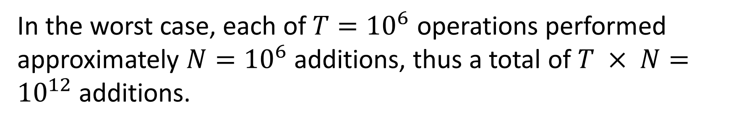
Concept (3)
For example :
Operation: [ 1 , 1000000, 99 ]
In the worst case, each of $T={10}^{6}$ operations performed approximately $N={10}^{6}$ additions, thus a total of $T × N={10}^{12}$ additions.
Range Left
Range Right
+99
+99
+99
+99
+99
$$S_{1}$$ | $$S_{2}$$ | $$S_{3}$$ | … | $$S_{999999}$$ | $$S_{1000000}$$
+99
estimate criterion is 10⁸ operations (+, -, *, /, =, ...) in 1 second !

Slide 32
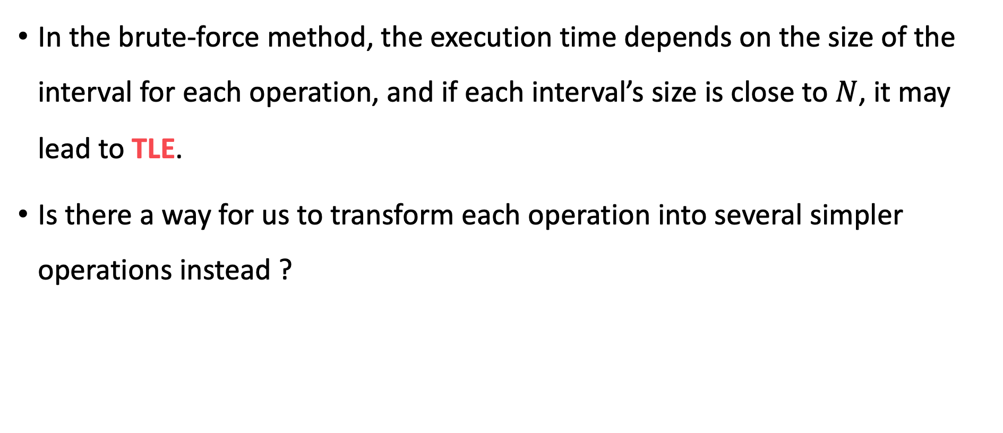
Concept (3)
In the brute-force method, the execution time depends on the size of the interval for each operation, and if each interval’s size is close to $N$, it may lead to TLE.
Is there a way for us to transform each operation into several simpler operations instead ?

Slide 33
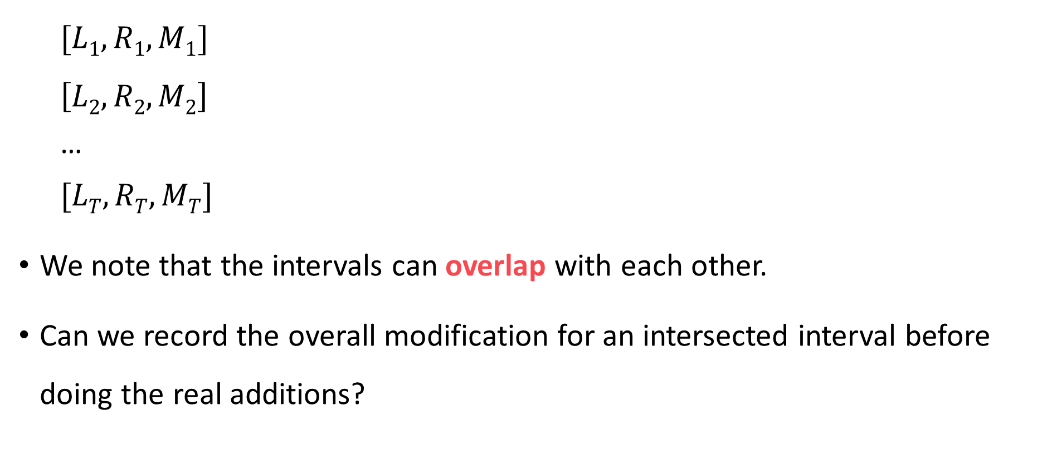
Concept (3)
$$[L1,R1,M1]$$
$$\left[L2,R2,M2\right]$$
…
$$[LT,RT,MT]$$
We note that the intervals can overlap with each other.
Can we record the overall modification for an intersected interval before doing the real additions?

Slide 34
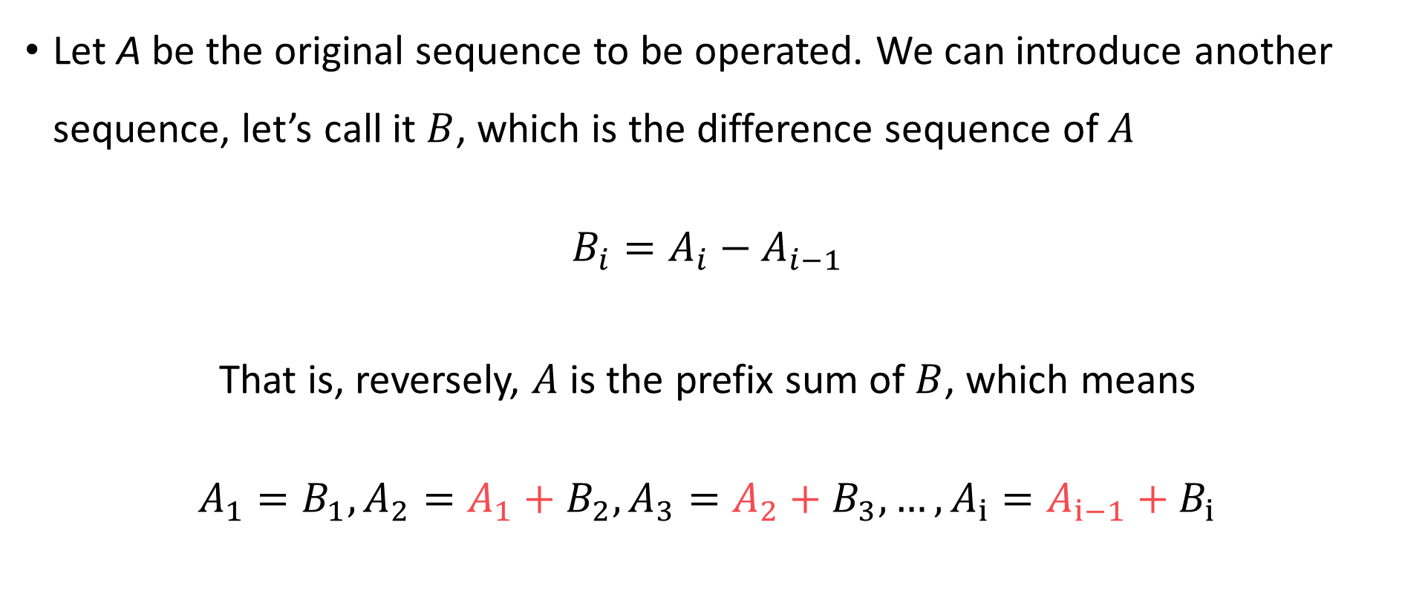
Concept (3)
Let A be the original sequence to be operated. We can introduce another sequence, let’s call it $B$, which is the difference sequence of $A$
$$B_{i}=A_{i}−A_{i−1}$$
That is, reversely, $A$ is the prefix sum of $B$, which means
$$A_{1}=B_{1}, A_{2}=A_{1}+B_{2}, A_{3}=A_{2}+B_{3}, …, A_{i}=A_{i−1}+B_{i}$$

Slide 35
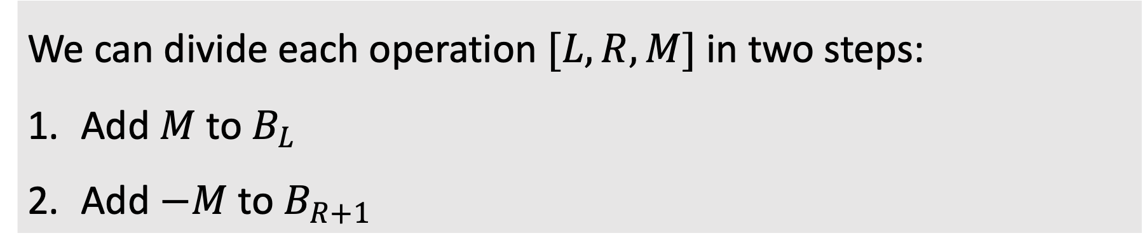




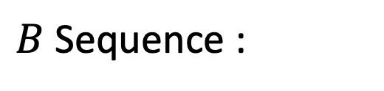
Concept (3)
Sample I/O :
$A$ Sequence :
$B$ Sequence :
$$1$$ | $$2$$ | $$3$$ | $$4$$
$$B_{i}=A_{i}−A_{i−1}$$
$$1$$ | $$1$$ | $$1$$ | $$1$$
We can divide each operation $[L, R, M]$in two steps:
Add $M$ to $B_{L}$
Add $−M$ to $B_{R+1}$
Notes:
Remove Constant time
Link concept (2-1) to (2-2)
Why B sequence

Slide 36
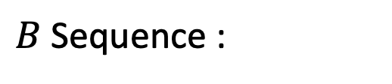

Concept (3)
Operation 1: [1, 2, 1]
$B$ Sequence :
+1
-1
1 | 1 | 1 | 1
We can divide each operation $[L, R, M]$in two steps:
Add $M$ to $B_{L}$
Add $−M$ to $B_{R+1}$

Slide 37
Concept (3)
Operation 1: [1, 2, 1]
$B$ Sequence :
2 | 1 | 0 | 1
We can divide each operation $[L, R, M]$in two steps:
Add $M$ to $B_{L}$
Add $−M$ to $B_{R+1}$

Slide 38
Concept (3)
Operation 2: [2, 3, 2]
$B$ Sequence :
+2
-2
2 | 1 | 0 | 1
We can divide each operation $[L, R, M]$in two steps:
Add $M$ to $B_{L}$
Add $−M$ to $B_{R+1}$

Slide 39
Concept (3)
Operation 2: [2, 3, 2]
$B$ Sequence :
2 | 3 | 0 | -1
We can divide each operation $[L, R, M]$in two steps:
Add $M$ to $B_{L}$
Add $−M$ to $B_{R+1}$

Slide 40
Concept (3)
Out of range !
But we can ignore it
It won’t affect the answer.
Operation 3: [3, 4, 4]
$B$ Sequence :
+4
-4
2 | 3 | 0 | -1
We can divide each operation $[L, R, M]$in two steps:
Add $M$ to $B_{L}$
Add $−M$ to $B_{R+1}$

Slide 41
Concept (3)
Operation 3: [3, 4, 4]
$B$ Sequence :
2 | 3 | 4 | -1
We can divide each operation $[L, R, M]$in two steps:
Add $M$ to $B_{L}$
Add $−M$ to $B_{R+1}$

Slide 42

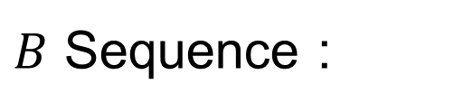
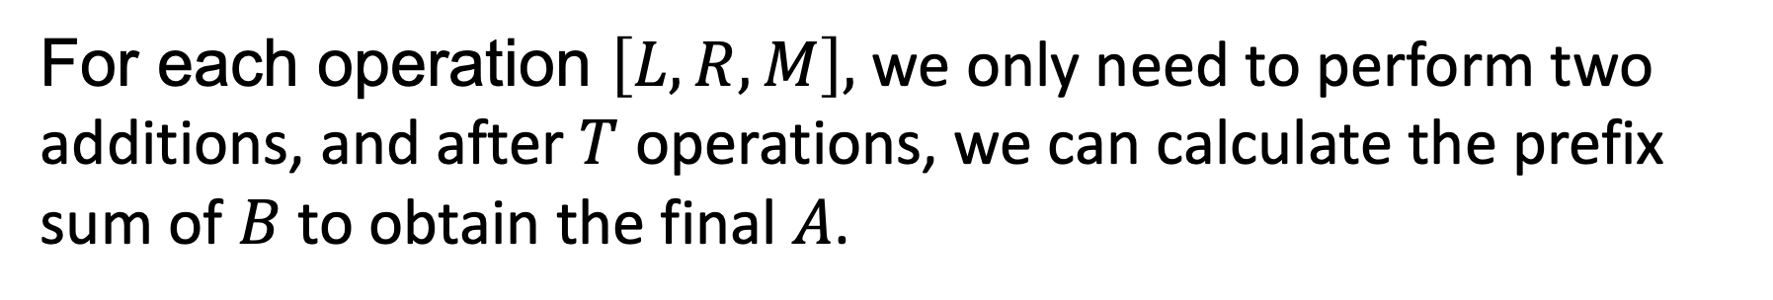




Concept (3)
Sample I/O :
$B$ Sequence :
$A$ Sequence :
$$2$$ | $$3$$ | $$4$$ | $$−1$$
$$A_{i}=A_{i−1}+B_{i}$$
$$2$$ | $$5$$ | $$9$$ | $$8$$
For each operation $\left[L, R, M\right],$ we only need to perform two additions, and after $T$ operations, we can calculate the prefix sum of $B$ to obtain the final $A$.
Why????
Notes:
Remove Constant time
Link concept (2-1) to (2-2)
Why B sequence

Slide 43
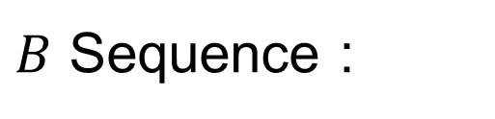
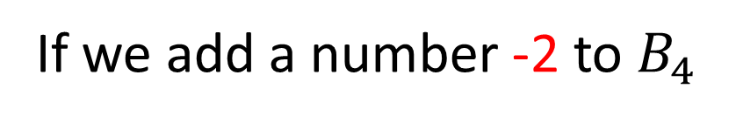
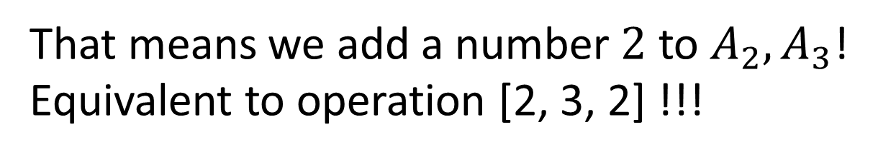





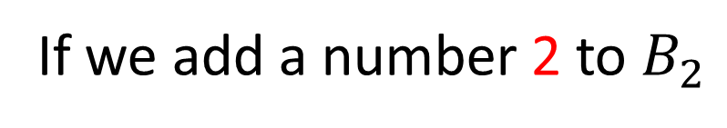

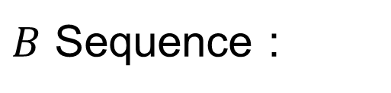

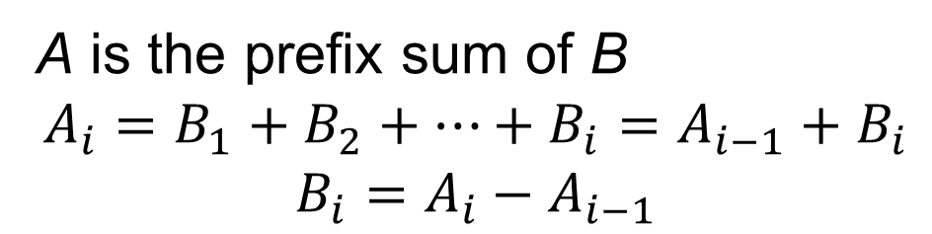
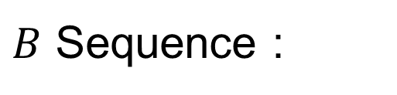


Concept (3)
A is the prefix sum of B
$$A_{i}=B_{1}+B_{2}+…+B_{i}=A_{i−1}+B_{i}$$
$$B_{i}=A_{i}−A_{i−1}$$
For operation [2, 3, 2] :
$B$ Sequence :
$A$ Sequence :
Prefix Sum
$$1$$ | $$1$$ | $$1$$ | $$1$$
$$1$$ | $$2$$ | $$3$$ | $$4$$
If we add a number -2 to $B_{4}$
If we add a number 2 to $B_{2}$
$B$ Sequence :
$A$ Sequence :
$B$ Sequence :
$A$ Sequence :
Prefix Sum
Prefix Sum
$$1$$ | $$1+2$$ | $$1$$ | $$1$$
$$1$$ | $$2+2$$ | $$3+2$$ | $$4+2$$
$$1$$ | $$1+2$$ | $$1$$ | $$1−2$$
$$1$$ | $$2+2$$ | $$3+2$$ | $$4$$
That means we add a number $2$ to $A_{2}, A_{3}$!
Equivalent to operation [2, 3, 2] !!!
That means we add a number $2$ to $A_{2}, A_{3}, …, A_{N}$ !
Notes:
從A構造出B

Slide 44
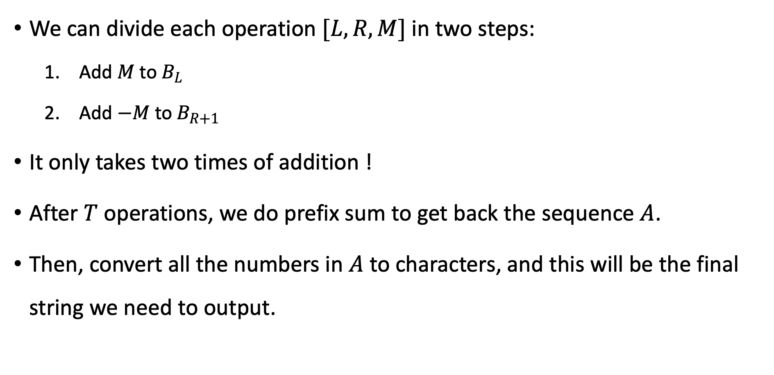
Concept (3)
We can divide each operation $[L, R, M]$in two steps:
Add $M$ to $B_{L}$
Add $−M$ to $B_{R+1}$
It only takes two times of addition !
After $T$ operations, we do prefix sum to get back the sequence $A$.
Then, convert all the numbers in $A$ to characters, and this will be the final string we need to output.

Slide 45

Code(1)
For a large array,
we recommend you to declare it as a global variable.
Usually,
the maximum size of local variables for each program will be 1MB or 2MB.
The size depends on your computer architecture.
#include <stdio.h>
#define MAX_SIZE 1000005
long long a[MAX_SIZE], b[MAX_SIZE];
int main(){
int t, n;
scanf("%d %d ", &t, &n);
for(int i = 1; i <= n; i++){
char c;
scanf("%c", &c);
a[i] = c - 'a';
b[i] = a[i] - a[i - 1];
}
Build sequence $B$
B[i]
A[i] – A[i – 1]

Slide 46
Code(2)
for (int i = 0, l, r, m; i < t; i++){
scanf("%d %d %d", &l, &r, &m);
b[l] += m;
b[r + 1] -= m;
}
Operation [L, R, X] :
A[L] + X, A[L + 1] + X, …, A[R] +X
B[L] + X
B[R + 1] - X

Slide 47
Code(3)
for (int i = 1; i <= n; i++){
a[i] = a[i - 1] + b[i];
printf("%c", (char)('a' + (a[i] % 26 + 26) % 26));
}
printf("\n");
After T operations
A[i]
A[i-1] + B[i]
Prefix Sum !!

